Slide 1
Byte Jumper
O
/|\
/ \
Ethan Eye, Aaron Villalobos, Ryan Craig

Slide 2
Byte Jumper
Create a platforming game
The player jumps from platform to platform as the screen constantly scrolls
See how long you can last

Slide 3
Why we chose...
We wanted to give ourselves a bit of a challenge
Wanted to make a game, but wasn't sure what
Interest for the game doodle jump, and wanted to replicate

Slide 4
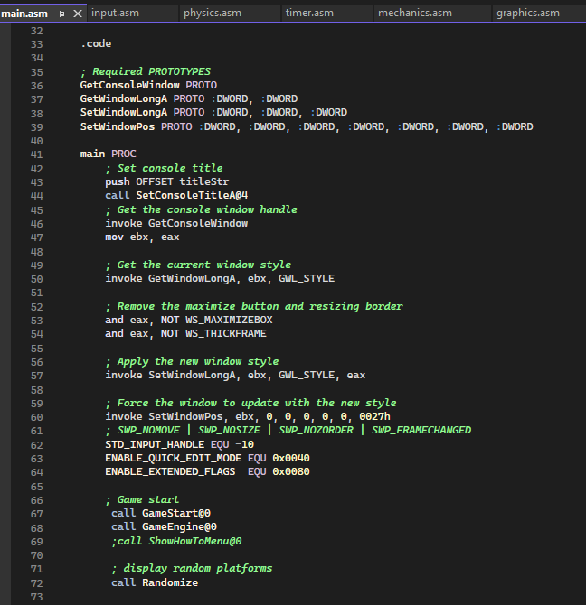
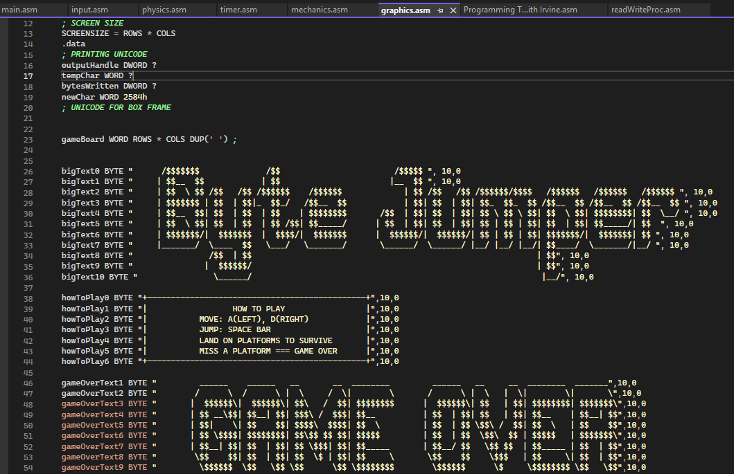
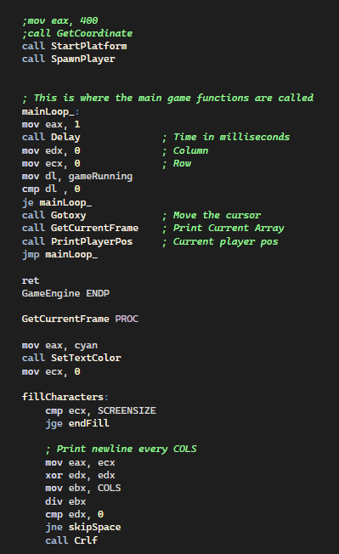
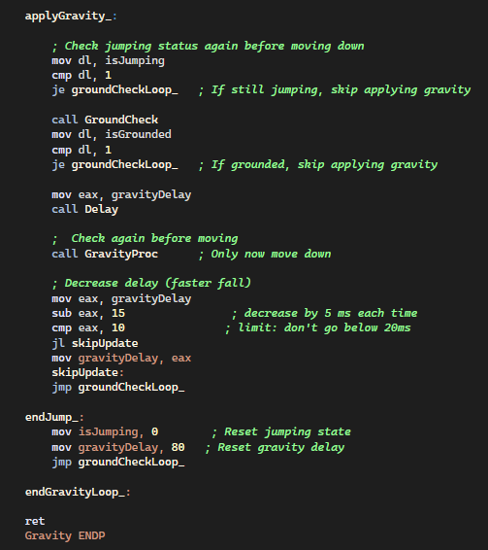
Screenshots

Slide 5
What went well
Coordination and planning
Smooth and clean coding
Well organized

Slide 6
What we could improve
Work on understanding GitHub
  Branch merging

Slide 7
Conclusion
Thank you!

